Slide 1

FATİH İLİĞ

Slide 2
Conditional Programming Construct
* If Else Statements
* Case Statement
* For Loops
* While Loops
Notes:
koşullu

Slide 3
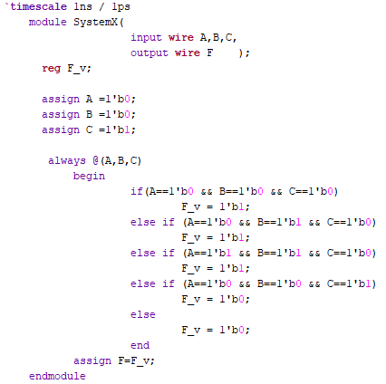
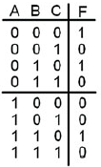
If Else Statements

Slide 4
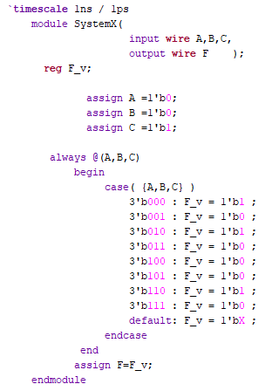
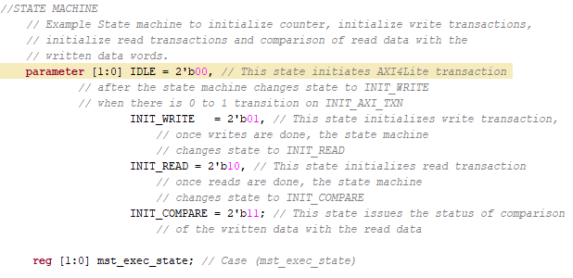
Case Statement

Slide 5
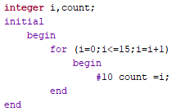
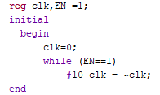
For Loops
While Loops

